Slide 1

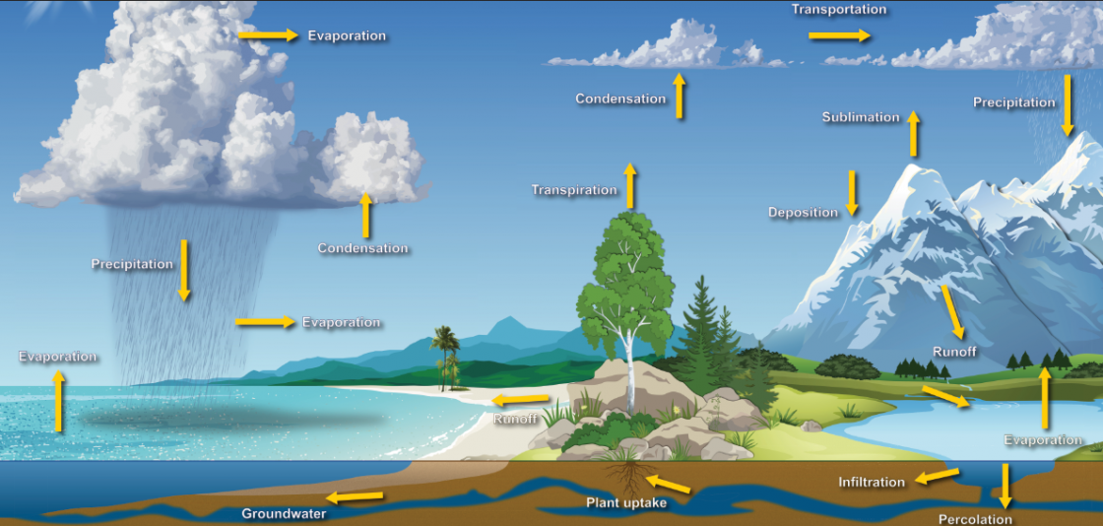
Cyber Meteorology Cloud to Lake and back again...
Defense Intelligence Agency
Directorate for Science & Technology
Special Briefing 04/01/21
UNCLASSIFIED
Notes:
Welcome, everyone!
My name is [REDACTED],
my hacker handle is “hackermatic”,
And my pronouns are she, her, and hers.
I’m excited to present this special unclassified briefing by the Defense Intelligence Agency’s Directorate for Science & Technology
on the new field of data science that we’ve come to call
“Cyber Meteorology.”

Slide 2
Agenda
Agenda
Cyber Meteorology Capability overview
Cyber Water Cycle
Clouds
Streams
Lakes
Data Precipitation
Cloud Umbrellas
Cyber Cloud Seeding
Summary
We Want YOU!
UNCLASSIFIED

Slide 3
Cyber Meteorology Capability overview
Data Science
an inter-disciplinary field that uses scientific methods, processes, algorithms and systems to extract knowledge and insights from structured and unstructured data, and apply knowledge and actionable insights from data across a broad range of application domains. Data science is related to data mining, machine learning and big data.
Projected to grow 23% in FY2021 (CBO projection)
Cyber Meteorology is a cross-functional silo using data science to achieve air superiority over the new Cloud environment
These taskings have enabled a comprehensive “Cyber Water Cycle” taxonomy
Force multiplier
Leveraging data for critical decisioning
UNCLASSIFIED
Notes:
As you all know, there’s a saying that “data is the new oil”, and it’s clear that data is the new battlespace as well.
That’s why DIA has invested heavily in data science over the last few years.

Slide 4
Cyber Water Cycle
Data inflows
Data outflows
Data flow analysis
Data temperature measurement
Notes:
Cyber Meteorology is about understanding and operationalizing the Data Water Cycle.
Inflows = how data gets to the Cloud (data streams, evaporation, etc.)
Outflows = how data gets out of the Cloud (precipitation, etc.)
Data flow analysis = what is the data’s position, heading, and velocity?
Data temperature measurement, i.e. relevance and pertinence

Slide 5
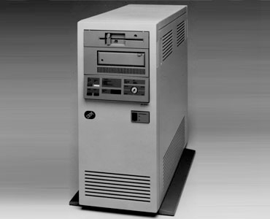

“The Cloud” is the key
Legacy data repositories were on-premises
Armed Forces digital transformation
Unlike data centers, Clouds can be floated to new locations as needed
“Bunker” versus “carrier” mentality
Enables new Big Data solutioning
“It’s all about Cloud!”
=
UNCLASSIFIED

Slide 6
Data Streams
Many different data streams lead to the Cloud
Database replication
Ongoing digitization of paper records (evaporation)
DIA moved 17 Libraries of Congress worth of data into our holistic “Data Watershed” during FY2020
Public Clouds – Microsoft Azure, Amazon AWS Web Services
Private Cloud
UNCLASSIFIED
Notes:
How does data get to the cloud? Data streams, of course!
The reason we have multiple Clouds will become clear in a few slides.

Slide 7
Data Lakes
For analyses that require higher data density than a Cloud can provide
Data streams can be fed directly into data lakes
Inflows must have a high data temperature to enable key insights
UNCLASSIFIED
Notes:
We Minnesotans know a thing or two about lakes!
But it’s not all happy-go-lucky in Cloud land...

Slide 8
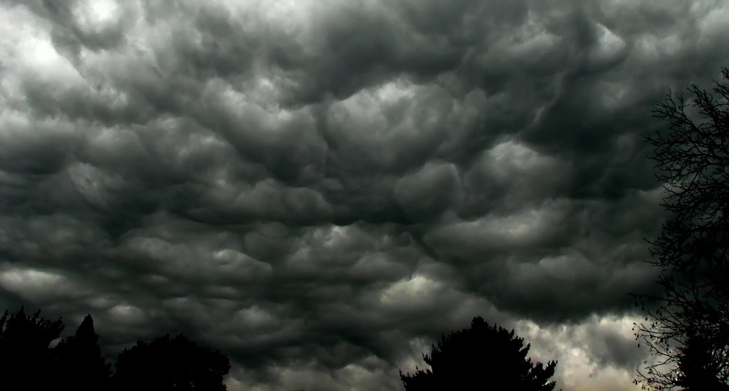
Data Precipitation
Adversaries who obtain access to our Clouds want to cause data precipitation to siphon away secrets and impact the digital battlespace
North Korea
Russia
WikiLeaks
Overconcentration of data in a single Cloud increases vulnerability to data condensation events
Key finding: Compartmentalize data in separate Clouds
UNCLASSIFIED
Notes:
The key threat our digital transformation is facing today is what we’ve come to call “data precipitation”, the causing of data to leave the Cloud.
Another emerging cyber weather threat is “solar wind” attacks

Slide 9
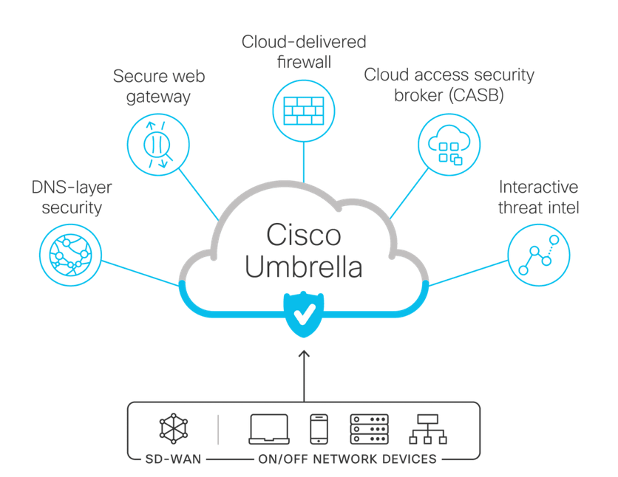
Cloud Umbrellas
Cloud Umbrellas are necessary to achieve data precipitation defense
Traditional Cloud Umbrellas deflect “denial of service” attacks that aim torrential amounts of data at targets
Inverse Cloud Umbrellas catch data before it leaks past our digital perimeter
NSA is solutioning Cloud Umbrella technology for NIPRNet and SIPRNet applications
Civilian solutions exist
Cisco Umbrella
Data Loss Prevention (DLP)
UNCLASSIFIED
Notes:
Like firewalls, but for the Cloud, where digital fire is not pertinent

Slide 10
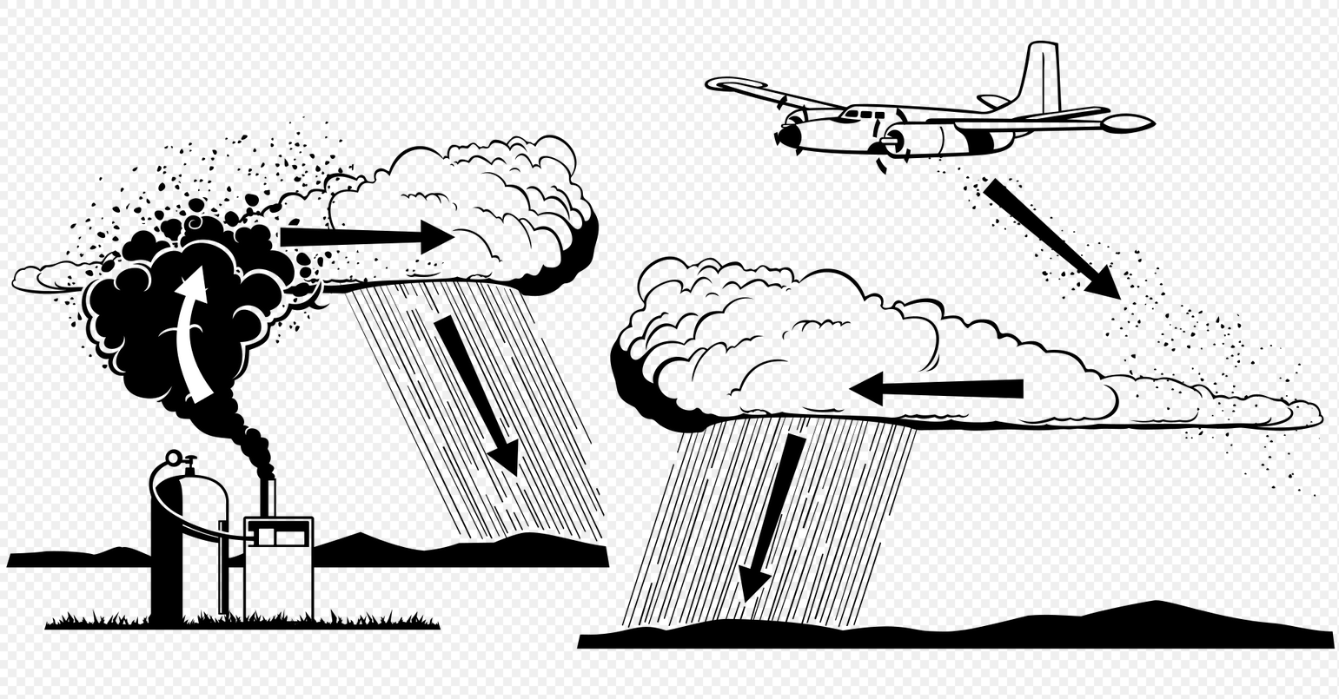
Cyber Cloud Seeding
Causing data precipitation events in an offensive capacity
SECDEF is strategically committed to achieving force parity with our adversaries’ cloud seeding capabilities for deterrence
See also Data Solvent Operations (DSO) group at CIA
What about threat attribution and cyber rangefinding (“hack back”)?
We are seeking partnerships with NGA and NOAA to provide GEOINT of hostile Cloud locations
Internal trial underway with DIA’s Project STAR GATE
UNCLASSIFIED?
Notes:
Data precipitation is a double-edged sword!

Slide 11

Summary
Cyber Meteorology Capability enables exciting new opportunities in the digital battlespace
Utilize the Cyber Water Cycle taxonomy to mitigate data precipitation events during a digital transformation
Cyber Cloud Seeding for future OFFSEC enablement
“It’s all about Cloud!”
UNCLASSIFIED

Slide 12

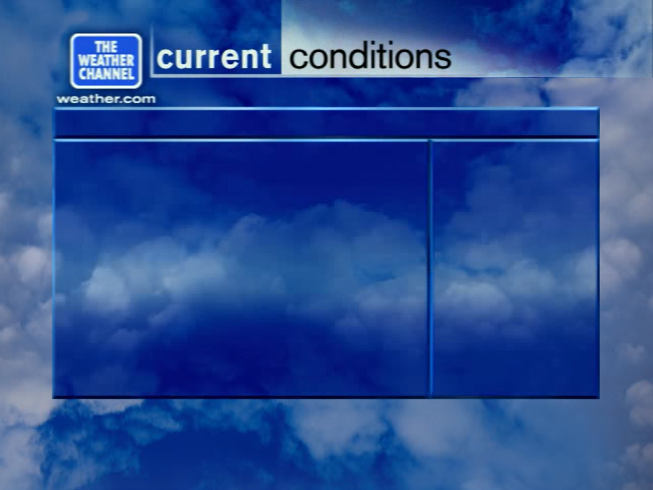
Cyber Meteorologists Wanted!
HOT AND CLOUDY WITH A CHANCE OF DATA PRECIPITATION. PACK AN UMBRELLA!
APPLY TO DIA AT DIAJOBS.DIA.MIL.
FOR THE DIA CYBER WEATHER SERVICE
UNCLASSIFIED

